Slide 1
Utilizing Pre-trained Model for Better Results
Transfer Learning
Dr. Muhammad Sajjad
R.A: Kaleem Ullah

Slide 2
Overview
Challenges in training custom Deep Learning models
Transfer Learning
How Transfer Learning Works
Kinds of Transfer Learning
Pre-trained Models
ImageNet
ImageNet Competition
AlexNet Architecture
LeNet5
VGG16/19
Problems with Very Deep Networks
RESNET
INCEPTON
1x1 Convolution
EFFICIENTNET
MobileNet
Applications of Transfer Learning

Slide 3
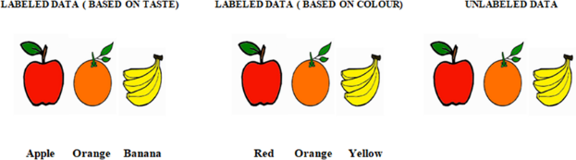
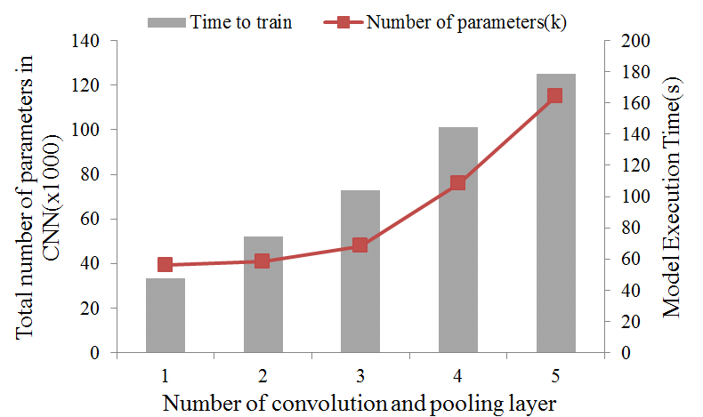
Challenges in Training Custom Deep Learning Models
Data:
Deep learning models typically require a large amount of labeled data to learn effectively.
Gathering and labeling this data can be time-consuming and expensive.
Without sufficient data, the model may not generalize well to new, unseen examples, leading to poor performance.
Training Time:
Training deep learning models can be computationally intensive and time-consuming.
Depending on the complexity of the model architecture, size of the dataset, and available computational resources, training can take days, weeks, or even longer.
Longer training times also increase the cost associated with experimentation and model development.
Notes:
https://www.researchgate.net/figure/Change-in-the-number-of-model-parameters-and-training-time-with-increased-number-of_fig3_335865710

Slide 4
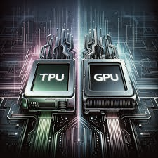
Challenges in Training Custom Deep Learning Models
Computational Resources:
Training deep learning models often requires significant computational resources, including powerful GPUs or even specialized hardware like TPUs.
Not everyone has access to these resources, limiting the ability to train complex models effectively.
Expertise Requirement:
Building and training custom deep learning models requires expertise in machine learning, deep learning, and software engineering.
This expertise may not be readily available to everyone, especially those new to the field.
Hyper parameter Tuning
Machine Learning Fundamentals
Machine Learning Engineer
Model Architecture Design
Programming Skills
Data Preprocessing
Mathematics and Statistics

Slide 5
Solution

Slide 6
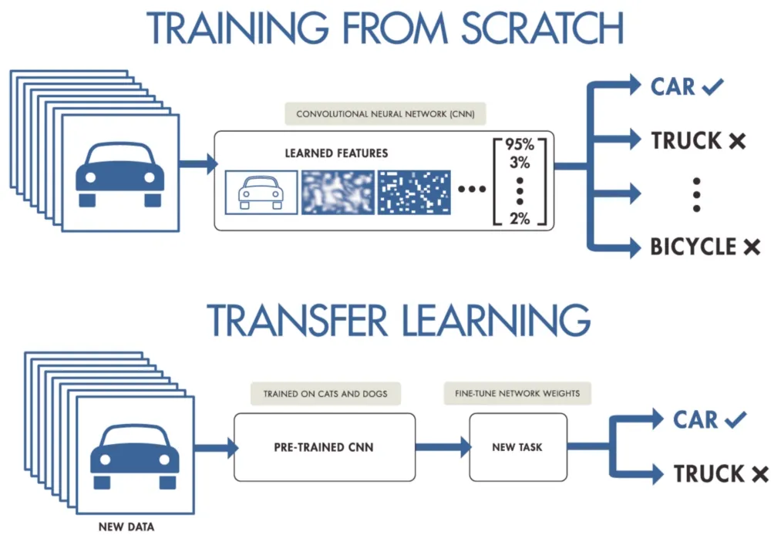
Transfer Learning
A powerful technique in deep learning that allows us to reuse knowledge gained from solving one problem to tackle a different but related problem.
Instead of training a model from scratch, we start with a pre-trained model and fine-tune it for the new task.
It will not only speed up training considerably, but also requires significantly less training data.
Need of Transfer Learning?
If our dataset is really small
Low Computation Power
If our dataset is similar to pre-trained data then we have to only fine tuning our model it would save lot of time.
Advantages:
Work with Limited data
Reduced training time
Improved neural network performance(in most cases)
Limitations
Dataset is completely different from pre-trained data.
Lots of Data
1
Medium amount of Data
Notes:
https://blog.devgenius.io/all-you-need-to-know-about-transfer-learning-4a7e3cbaf1dd

Slide 7
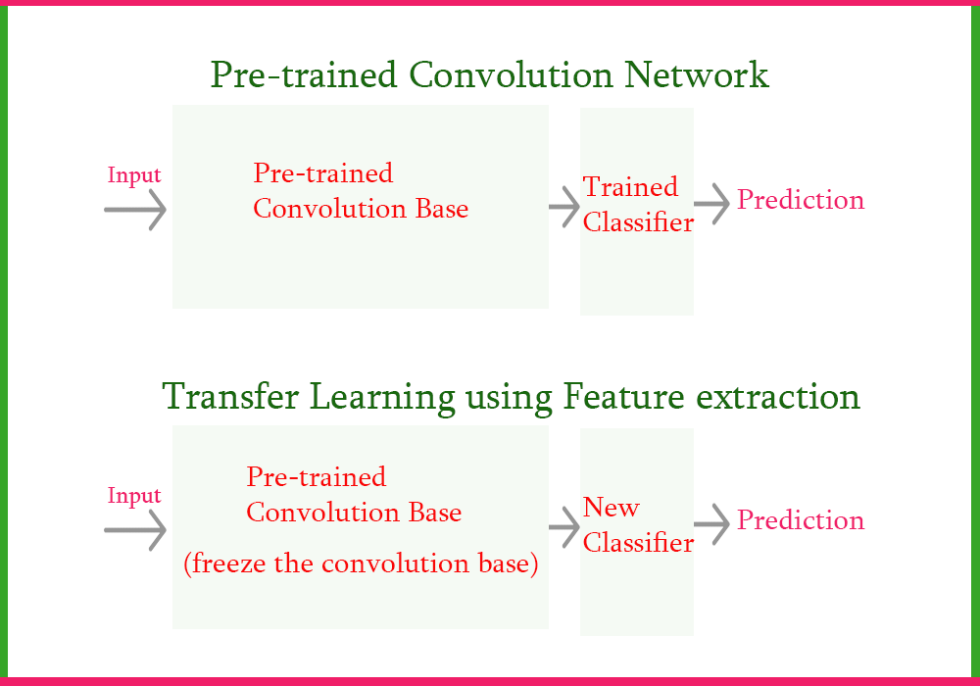
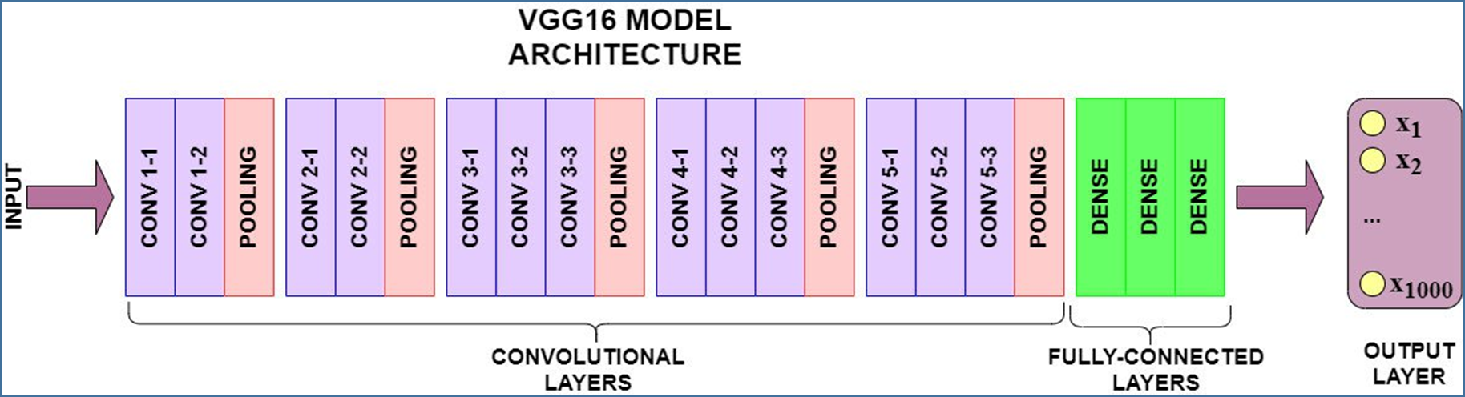
How Transfer Learning Works
Pre-trained Model:
Begin with a model that has already been trained on a large dataset for a specific task (e.g., image classification using ImageNet).
This pre-trained model has learned useful features and patterns from the data.
Application to a New Task:
Add new task-specific layers (e.g., an output layer) on top of the base model.
Fine-tune the entire model on the new task using a smaller dataset.
The base model’s features are leveraged for the new task.
Unfreeze the Last Layer
Notes:
https://medium.com/@nutanbhogendrasharma/transfer-learning-using-feature-extraction-in-deep-learning-afd97380c96c

Slide 8
Kinds of Transfer Learning
Feature Extraction:
Use the base model as a fixed feature extractor.
Extract features from intermediate layers (e.g., convolutional layers in a CNN).
Feed these features to a new classifier (e.g., a fully connected layer).
Commonly used when data for the new task is limited.
Fine-Tuning:
Fine-tune layer in the base model for the new task.
Adjust the weights of the base model using the new task’s data.
Useful when the new task is closely related to the original task.

Slide 9
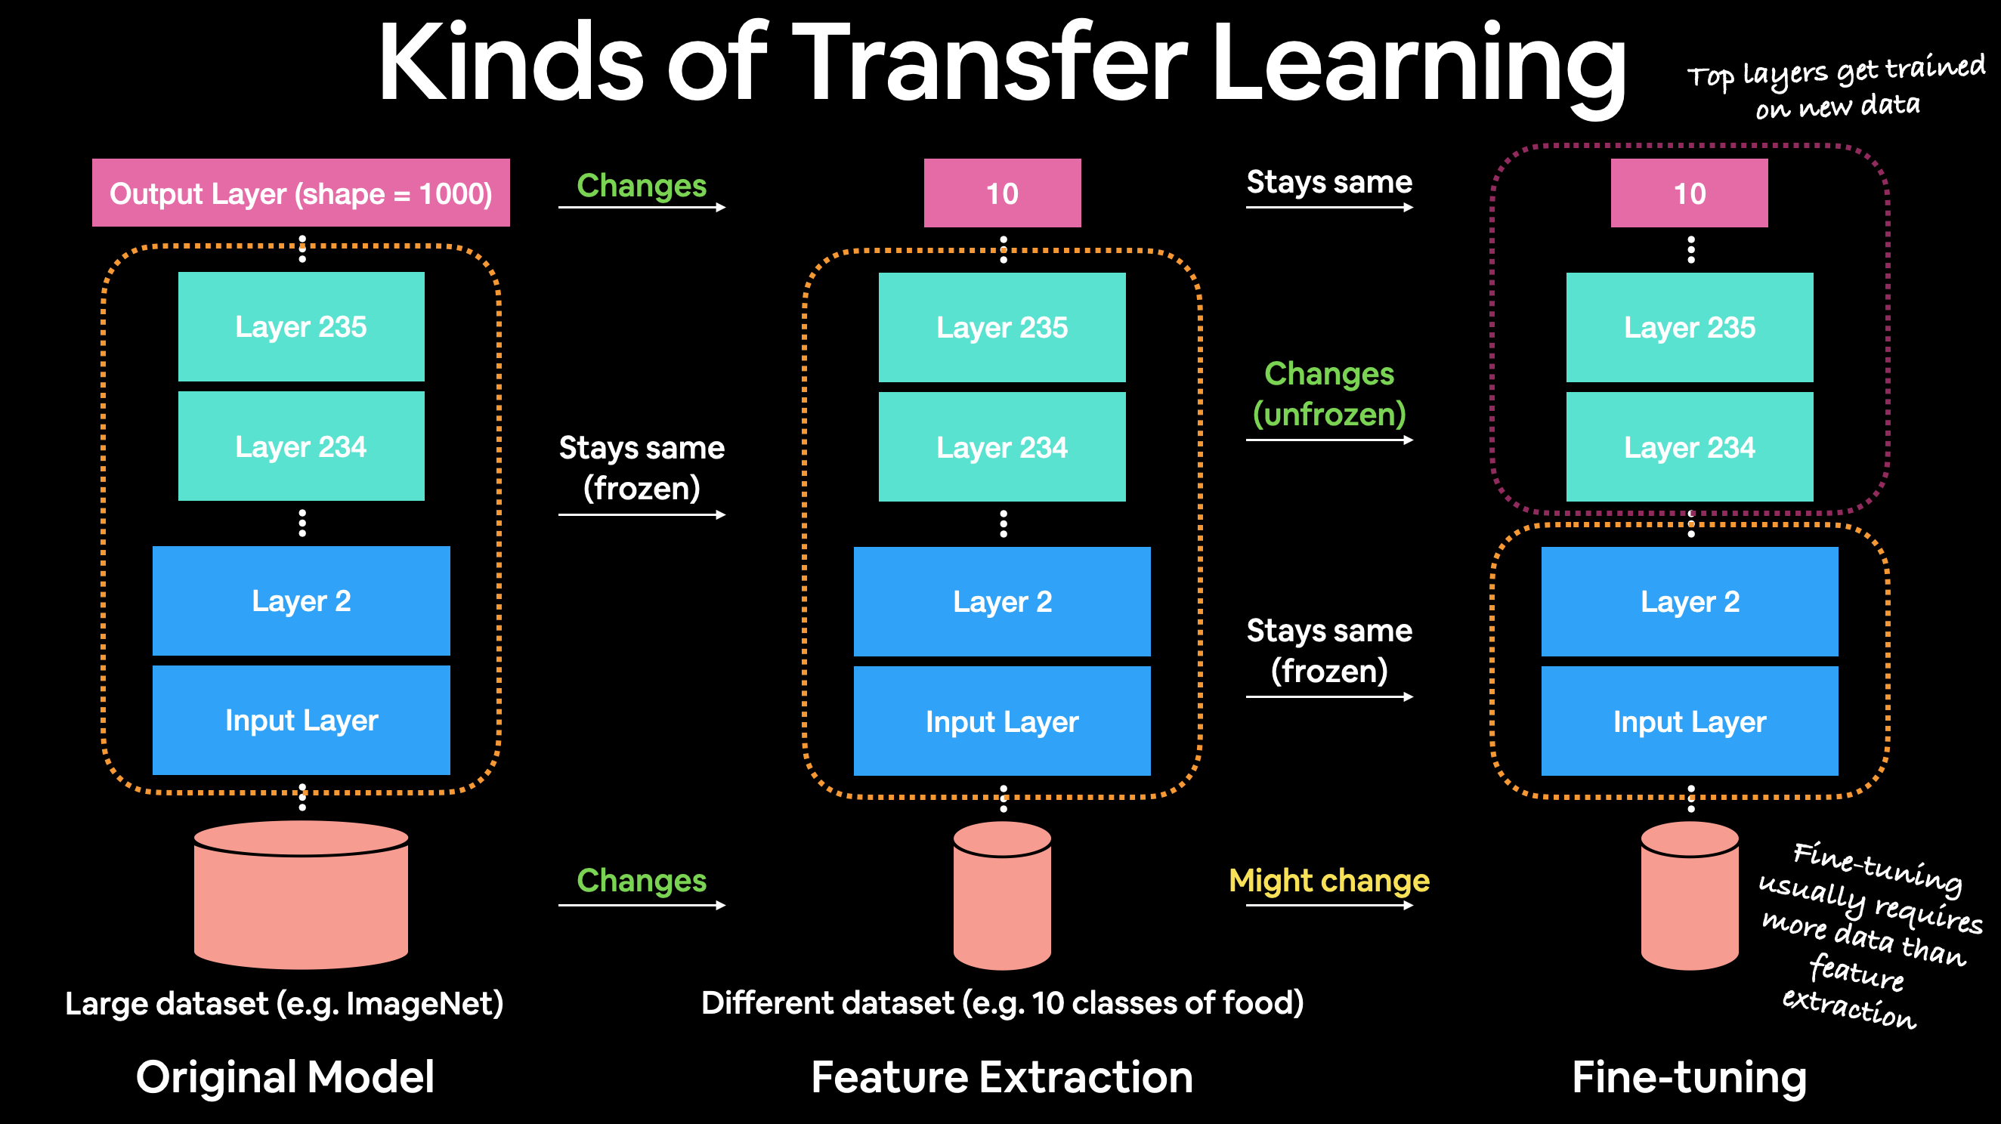
Notes:
https://dev.mrdbourke.com/tensorflow-deep-learning/04_transfer_learning_in_tensorflow_part_1_feature_extraction/

Slide 10
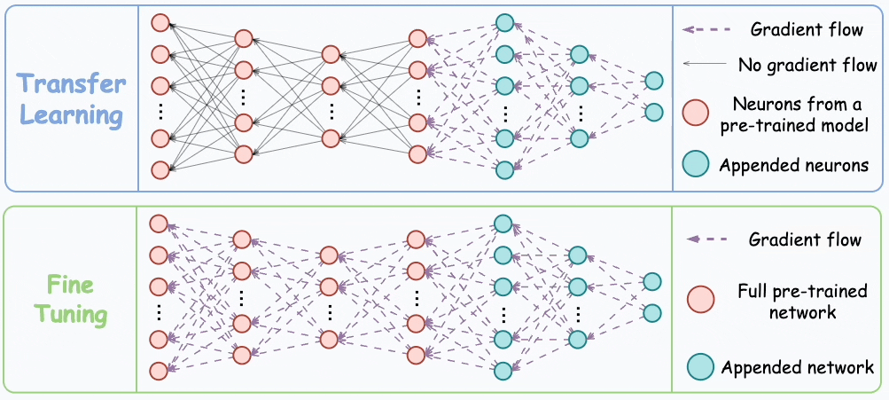

Slide 11
Pre-trained Models

Slide 12
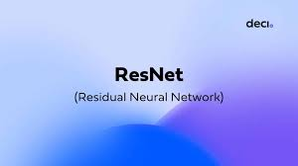

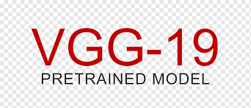
A pre-trained model is a deep learning model that has been trained on a large dataset and can be fine-tuned for a specific task.
Pre-trained models serve as a starting point for developing deep learning models.
They provide initial weights and biases that can be fine-tuned for specific tasks.
Reuse lower layers of a pre-trained model for feature extraction, training only the final layers specific to your project.
Benefits:
Save time and resources.
Achieve higher accuracy with pre-learned features.
Access models trained on large datasets (e.g., ImageNet with 14 million images).
Efficiency
Performance
Accessibility
Notes:
https://encord.com/glossary/pre-trained-model-definition/

Slide 13
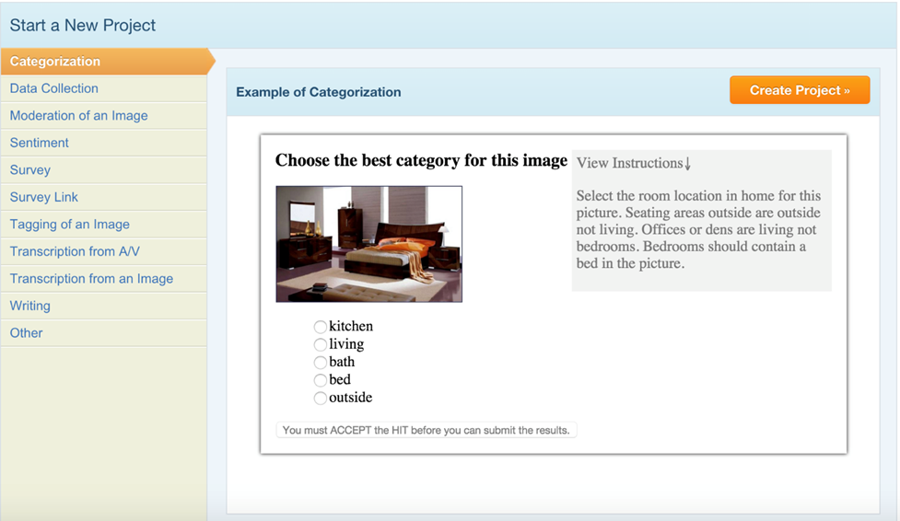
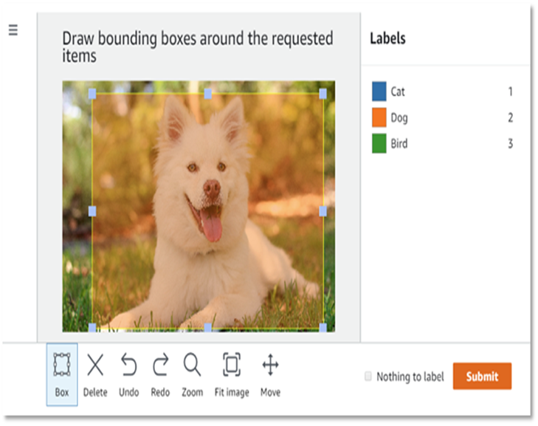
ImageNet
The ImageNet dataset contained over 14 million labeled images.
The dataset contains more than 20,000 categories.
A prominent computer scientist, Fei-Fei Li, co-founded the ImageNet project in 2009 (initiated in 2006) along with other researchers. Their work on ImageNet significantly advanced computer vision research and deep learning development.
There are 1 million Images with bounding box labelling as well for the purpose of Object Localization task, where the goal is to identify not only the object but also its precise location within the image.
They used Amazon Mechanical Turk to help with the classification of images.
Amazon Mechanical Turk (MTurk) is great for crowdsourcing tasks using images.
Notes:
https://en.wikipedia.org/wiki/ImageNet
https://blog.mturk.com/tutorial-how-to-label-thousands-of-images-using-the-crowd-bea164ccbefc

Slide 14

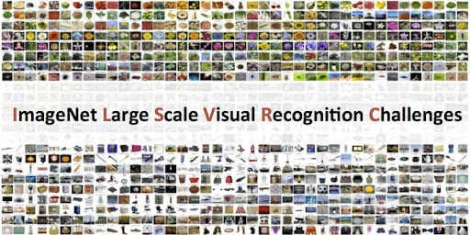
ImageNet Competition
The ImageNet Large Scale Visual Recognition Challenge (ILSVRC) starts in 2010 , and the goal was to Highlight the best model for classification to the research Community.
The dataset which were used in the challenge was a subset of ImageNet which consists of around 1.2 million images from 1000 classes.
At first The peoples were use ML Algorithms.
The Error rate was 28% for the first time.
In 2011 the error rate reduces to 25% using ML algorithms.
The Revolution in 2012 when Geoffrey Hinton Participated in this challenge with his CNN based Model AlexNet.
It’s effective implementation of deep learning algorithm, ReLU as an activation function and as well as uses GPU instead of CPU, significantly improved performance.
AlexNet achieved a significantly lower error rate in the ILSVRC 2012 competition compared to previous approaches.

Slide 15
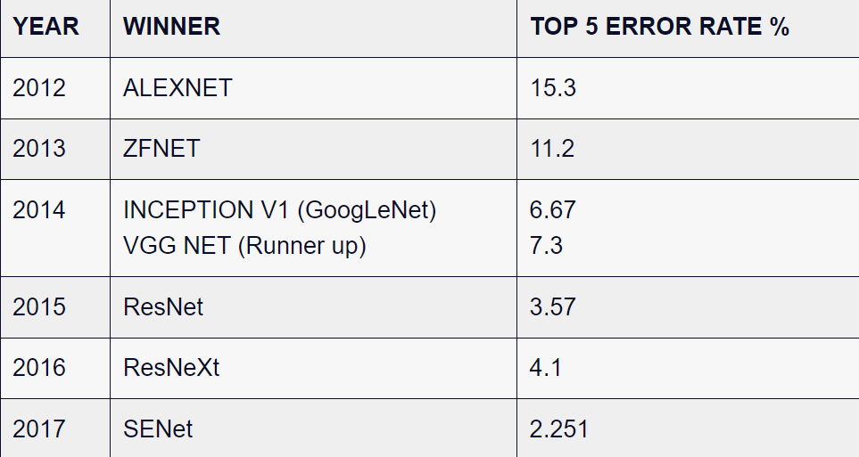
Winning Models of the ImageNet Competition

Slide 16
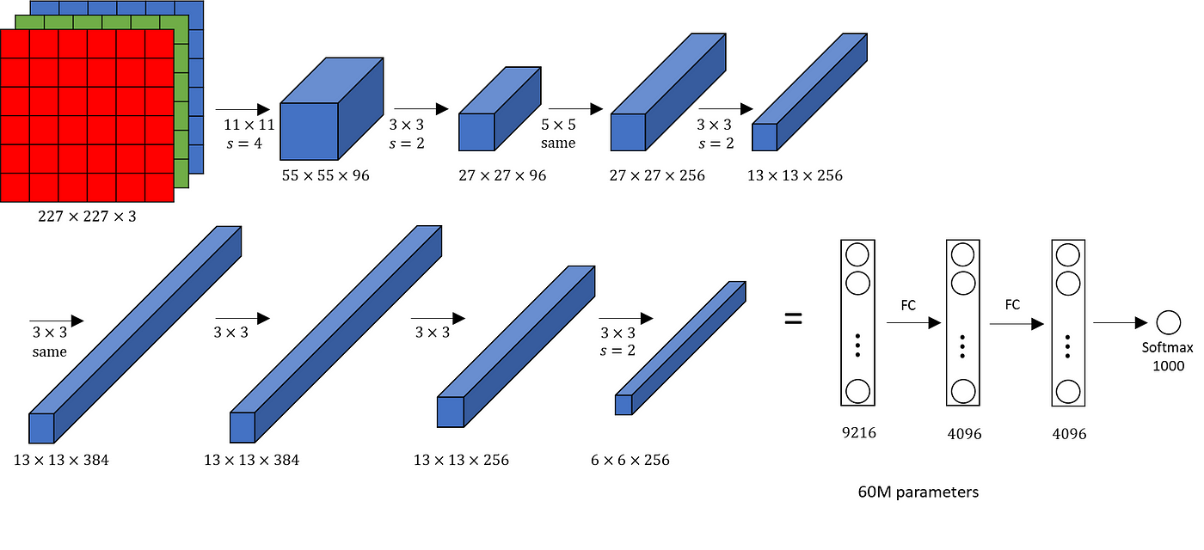
AlexNet Architecture
Notes:
https://medium.com/@siddheshb008/alexnet-architecture-explained-b6240c528bd5
62.3 million learnable parameters.

Slide 17
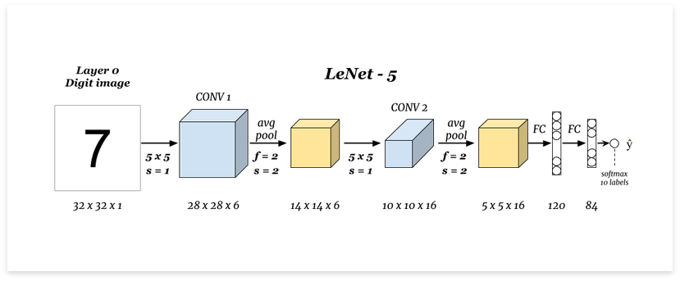
LeNet5 Architecture
LeNet-5 is the earliest CNN architecture, developed by Yann LeCun, Léon Bottou, Yoshua Bengio, and Patrick Haffner in 1998.
It was primarily designed for handwritten digit recognition tasks, particularly recognizing digits in postal codes on letters
Notes:
https://www.philschmid.de/getting-started-with-cnn-by-calculating-lenet-layer-manually

Slide 18
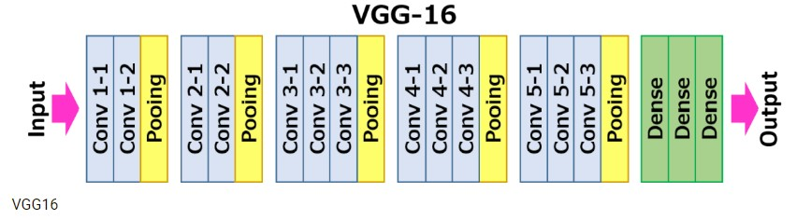
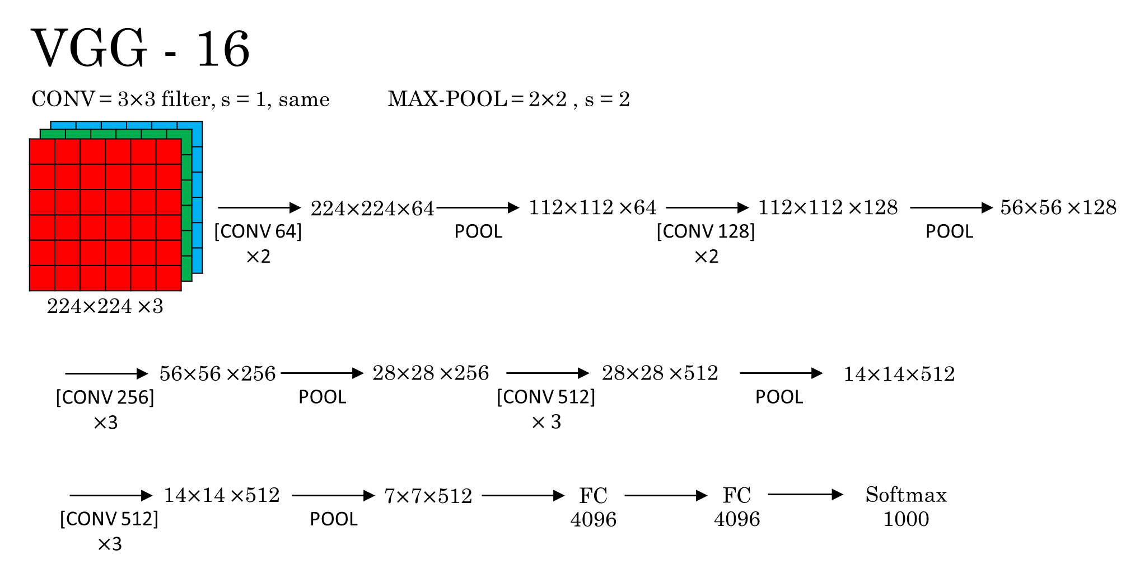
VGG16/19 Architecture
VGG-16 model, created by the Visual Geometry Group at the University of Oxford.
The VGG-16 model is a 16-layer (convolution and fully connected) network built on the ImageNet database, which is built for the purpose of image recognition and classification.
Notes:
https://medium.com/@mygreatlearning/everything-you-need-to-know-about-vgg16-7315defb5918

Slide 19
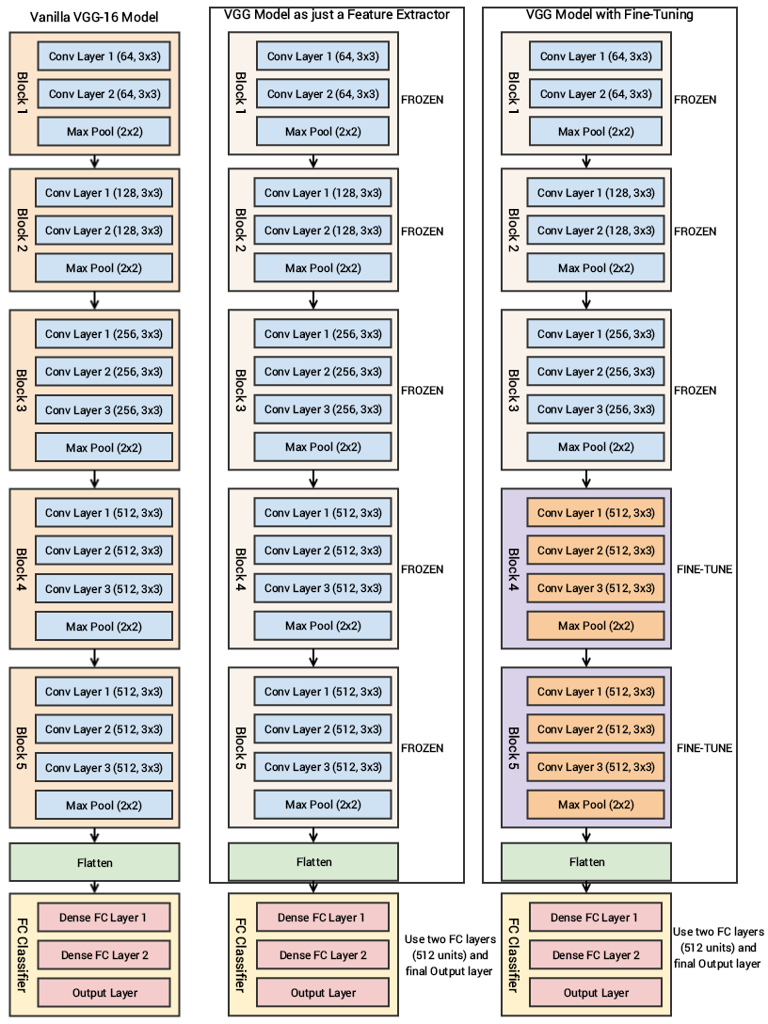

Slide 20
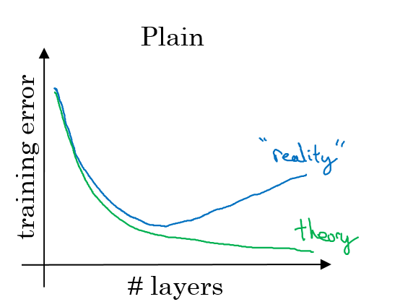
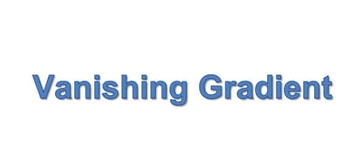
Problems with Very Deep Networks
Initial Belief:
Increasing the number of layers in a neural network would consistently improve accuracy.
Practical Issues:
No generalization
Vanishing gradient
Exploding gradients
Hampered training and limited performance
Exploding Gradients

Slide 21
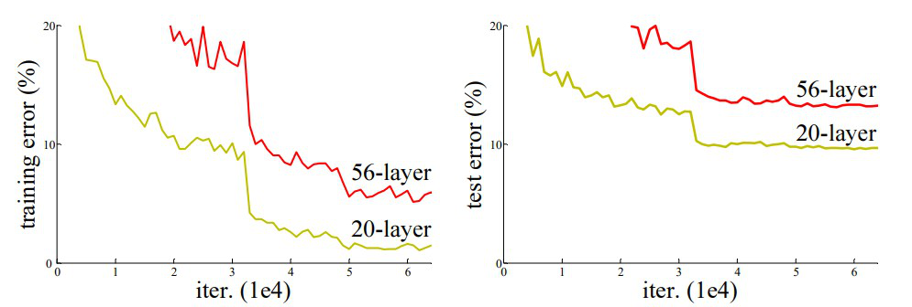
Vanishing/Exploding Gradients Problems:
In deep neural networks, during backpropagation, gradients can become extremely small.
This happens as they are propagated back through the network.
Vanishing Gradient Problem:
During backpropagation, gradients can become extremely small.
Lower layers' weights remain unchanged, hindering convergence..
Exploding Gradients Problem:
During backpropagation, Gradients grow larger, leading to unstable training.
Results in excessively large weight updates.
Often observed in recurrent neural networks.
It makes learning difficult, particularly in deeper layers.
Comparison of 20-layer vs 56-layer architecture
Notes:
https://www.geeksforgeeks.org/residual-networks-resnet-deep-learning/

Slide 22
Solution

Slide 23
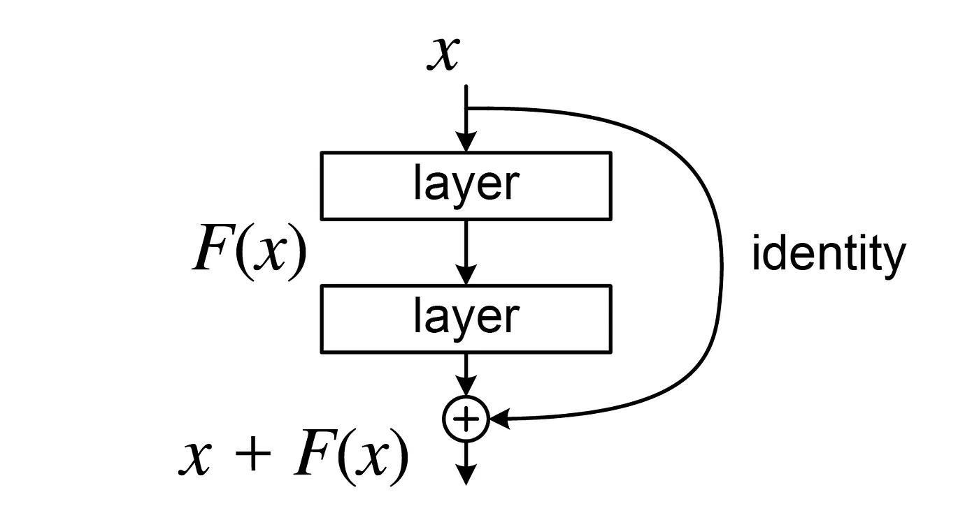
Residual Learning
Skip Connections:
A shortcut connection in a neural network that bypasses some layers and directly feeds the output of an earlier layer to a later layer.
Helps in bypassing any layer that may degrade performance, effectively regularizing the network.
Residual Blocks:
Introduce skip connections to address vanishing/exploding gradient issues.
Form the basic building blocks of ResNet.
Residual Mapping:
Instead of learning the underlying mapping 𝐻(𝑥), the network learns the residual 𝐹(𝑥) where 𝐹(𝑥):=𝐻(𝑥)−𝑥
Allows the network to fit the function 𝐻(𝑥):=𝐹(𝑥)+𝑥.
Advantages:
Mitigates vanishing/exploding gradient problems.
Enables training of very deep neural networks.
Improves performance and generalization.
A Residual Block in a deep Residual Network. Here the Residual Connection skips two layers

Slide 24
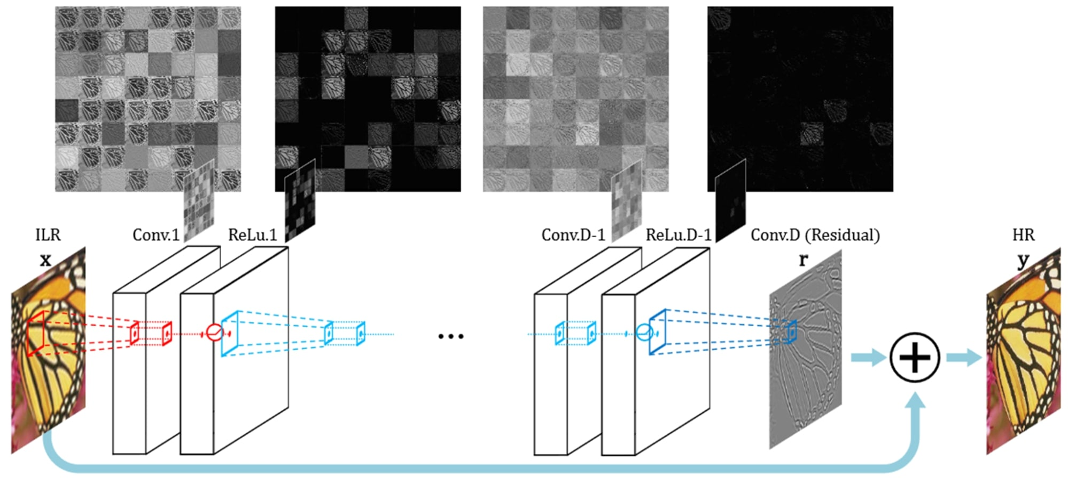
Residual Learning

Slide 25
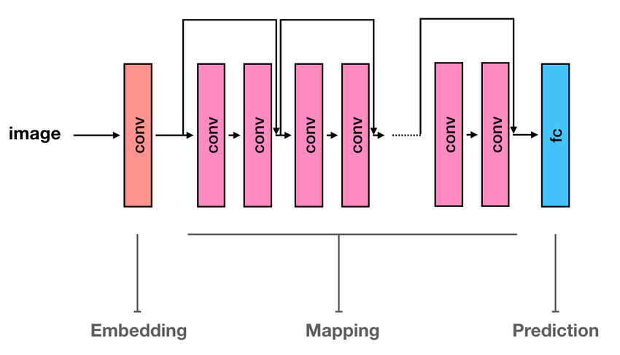
ResNet
ResNet was proposed in 2015 by researchers at Microsoft Research introduced a new architecture called Residual Network.
A Residual Neural Network (ResNet) is an Artificial Neural Network (ANN) of a kind that stacks residual blocks on top of each other to form a network.
ResNet first introduced the concept of skip connection.
Winner of the ImageNet Challenge in 2015 with an error rate of 3.57%.
ResNet50 is a variant of ResNet model which has 48 Convolution layers along with 1 MaxPool and 1 Average Pool layer
Variants of ResNet architecture
Resnet-18, Resnet-34, Resnet-50, Resnet-101, Resnet- 152. The number after all the model is the number of layers in the model.
Notes:
https://viso.ai/deep-learning/resnet-residual-neural-network/
https://www.researchgate.net/figure/A-schematic-view-of-ResNet-architecture-15-decomposed-into-three-blocks-embedding_fig1_333475917

Slide 26
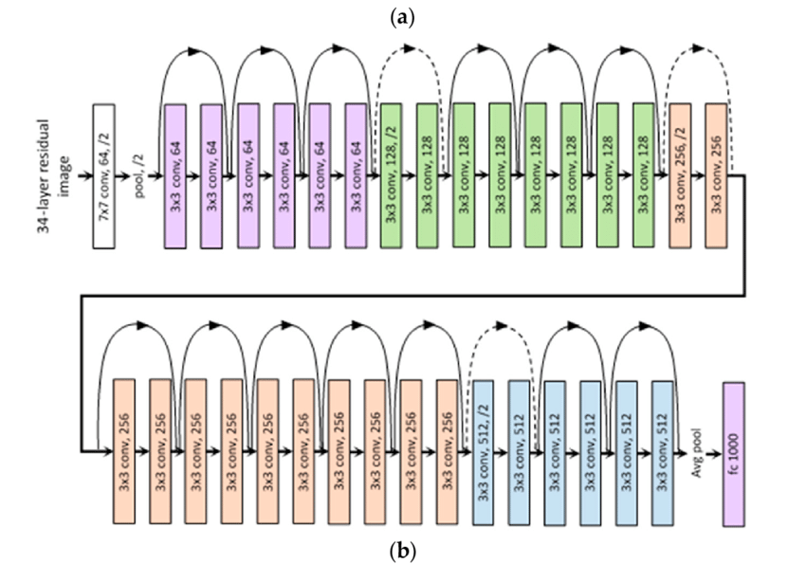
ResNet-34 Layered architecture
Notes:
https://medium.com/@siddheshb008/resnet-architecture-explained-47309ea9283d

Slide 27
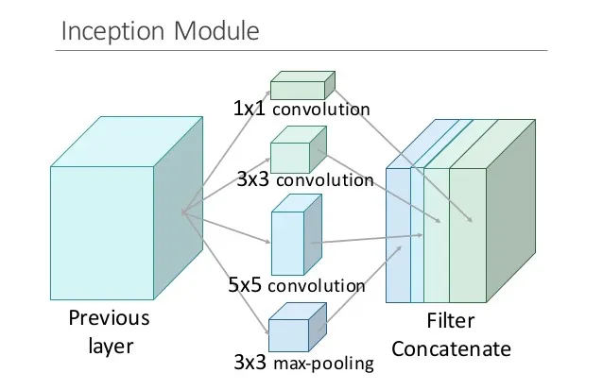
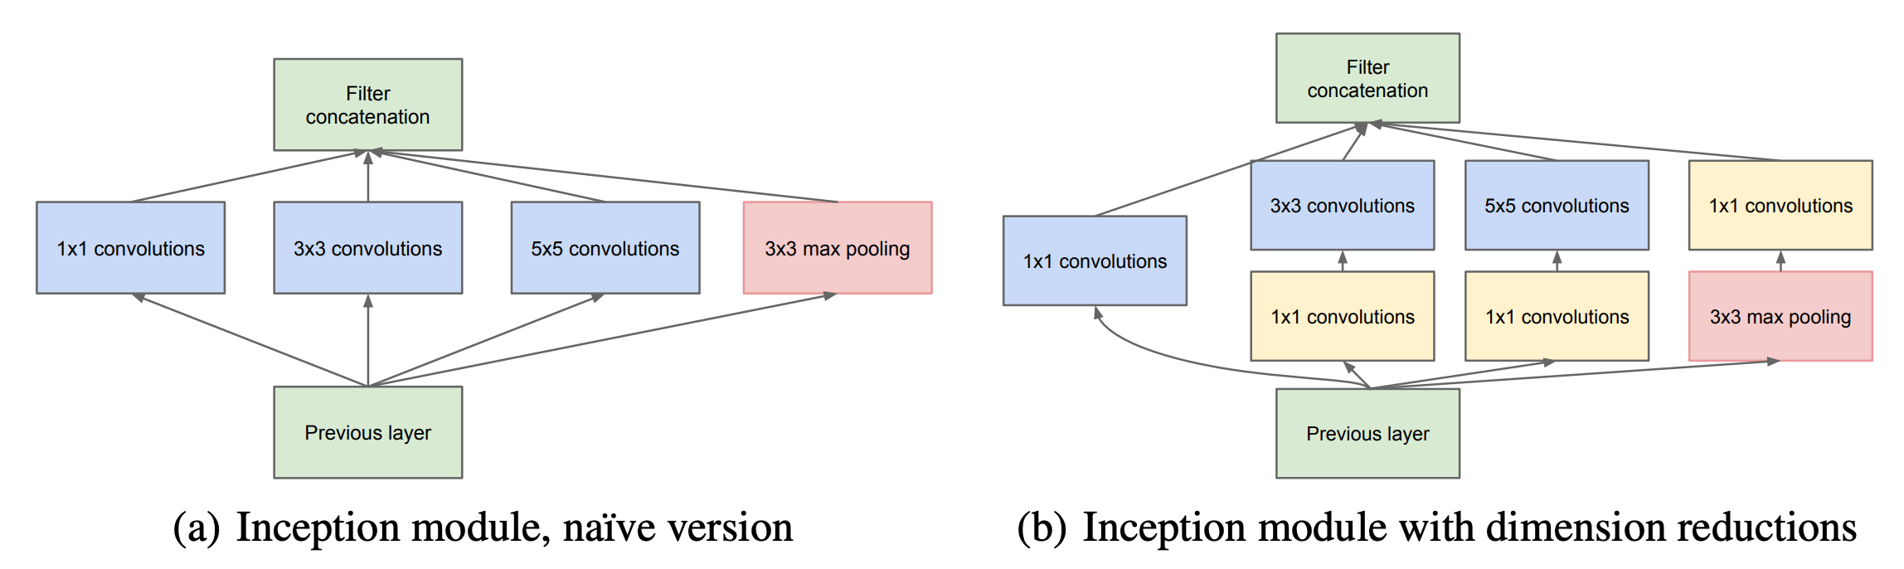
Inception
Inception Module:
Utilizes multiple convolutional filters (1x1, 3x3, 5x5) and pooling operations within the same module.
While some networks like VGG16 focus only on 3x3 or LeNet5 on 5x5, Inception makes sure to grab all kinds of features.
By using various filter sizes, Inception can pick up both small and big details in the data.
Captures information at different scale.
Notes:
https://velog.io/@snoop2head/Going-Deeper-with-Convolutions-GoogleNet-Inception
https://towardsdatascience.com/an-intuitive-guide-to-deep-network-architectures-65fdc477db41

Slide 28
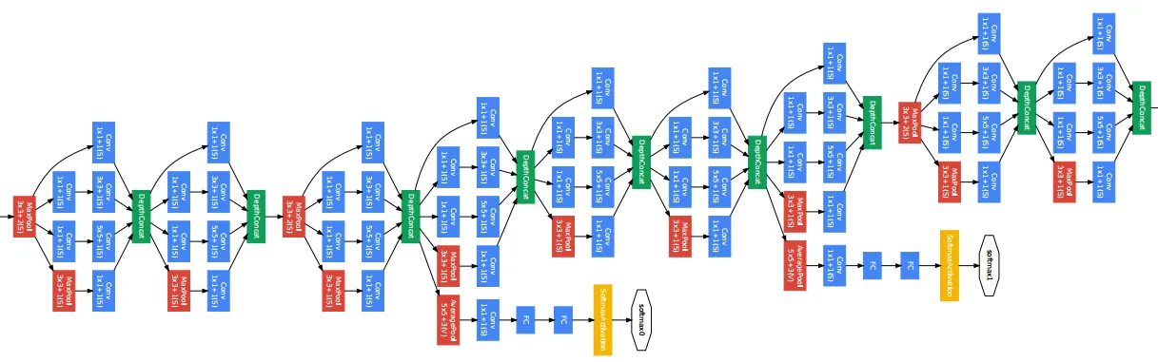
Inception Pre-trained Models:
Inception-v1 (GoogLeNet), Inception-v2, Inception-v3, Inception-v4.
Notable Achievements:
Inception-v1 (GoogLeNet) won the 2014 ImageNet Challenge with a top-5 error rate of 6.67%.
GoogLeNet, 2014

Slide 29
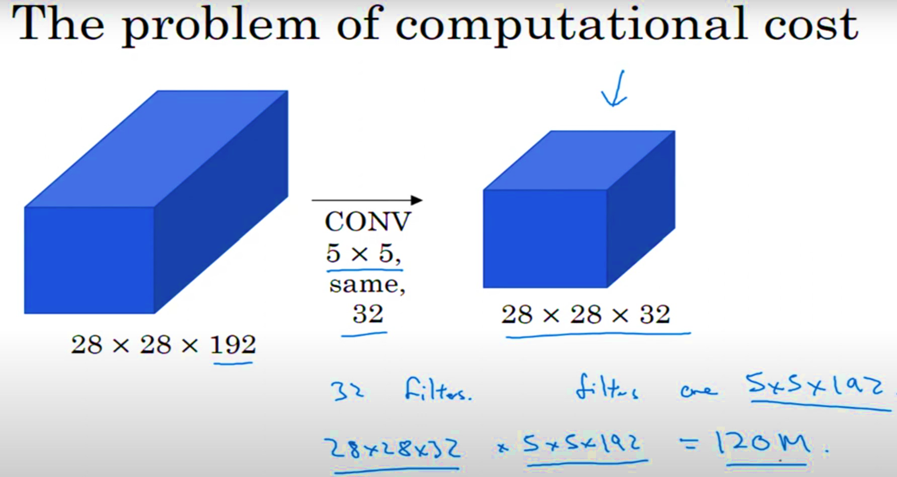
The Problem of Computational Cost

Slide 30
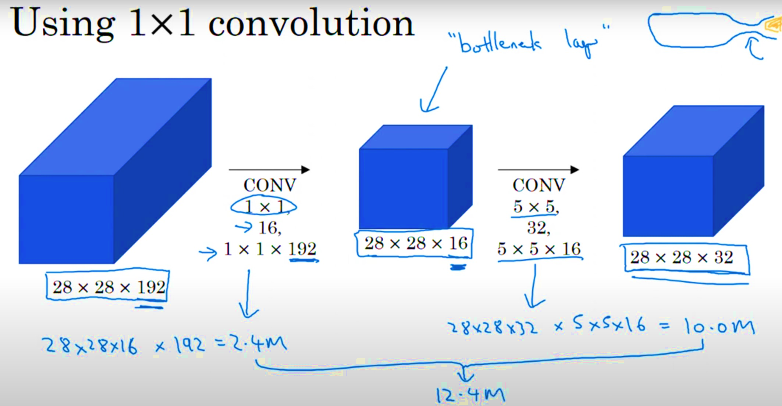
Solution
Less Parameters means Less Computational Cost.
Add 1*1 Conv before 3*3
Add 1*1 Conv before 5*5
And Add 1*1 Conv after the 3*3 Maxpool layer.

Slide 31
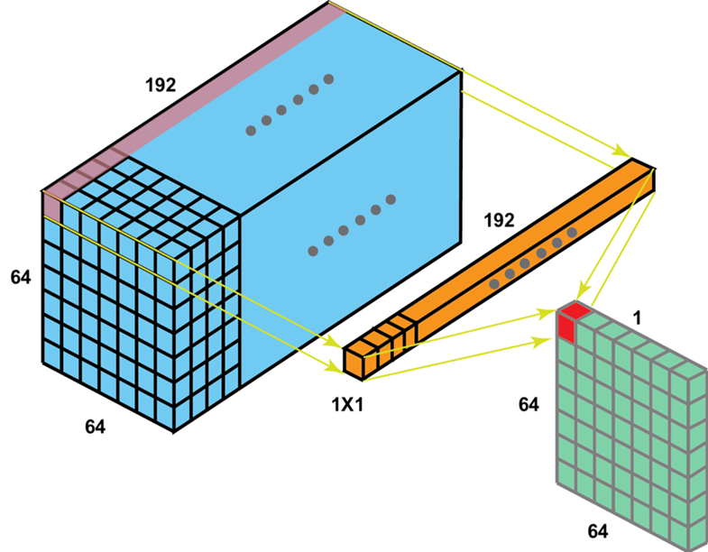
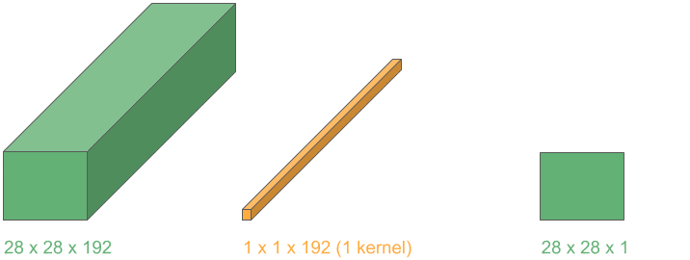
1x1 Convolution
A 1x1 convolution applies a single 1x1 filter to each pixel in the input volume.
It processes each pixel individually but across all channels (depth), combining the information from different channels.
Purpose:
Reduces the number of channels while retaining spatial dimensions.
Enables efficient dimensionality reduction and computational cost savings.
Applications
ResNet: Used in bottleneck blocks for efficiency.
MobileNet: Part of depthwise separable convolutions.
Inception Modules: Reduces dimensions before expensive convolutions.
Notes:
https://www.youtube.com/watch?app=desktop&v=pf-HUcqdCr4
https://www.baeldung.com/wp-content/uploads/sites/4/2020/06/3D_1D_cropped.gif

Slide 32
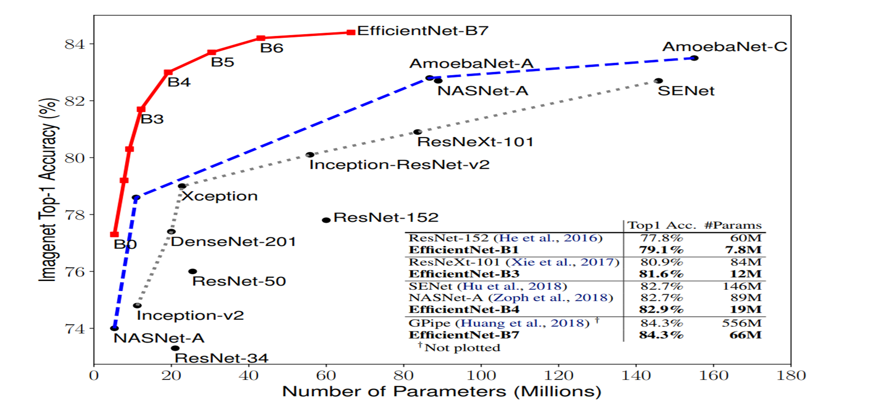
EfficientNet
Introduced in 2019 by a team of researchers at Google AI,
The most powerful CNN architecture
EfficientNet is built upon a concept called compound scaling.
Compound scaling optimizes model depth, width, and resolution for optimal efficiency.
Applications:
Image classification, object detection, semantic segmentation
EfficientNet Variants
EfficientNet B0-B7: A family of EfficientNet models with varying complexities.
B0: Most lightweight (5.3 million parameters).
B7: Most complex (6.1 billion parameters).
Notes:
https://arxiv.org/abs/1905.11946

Slide 33
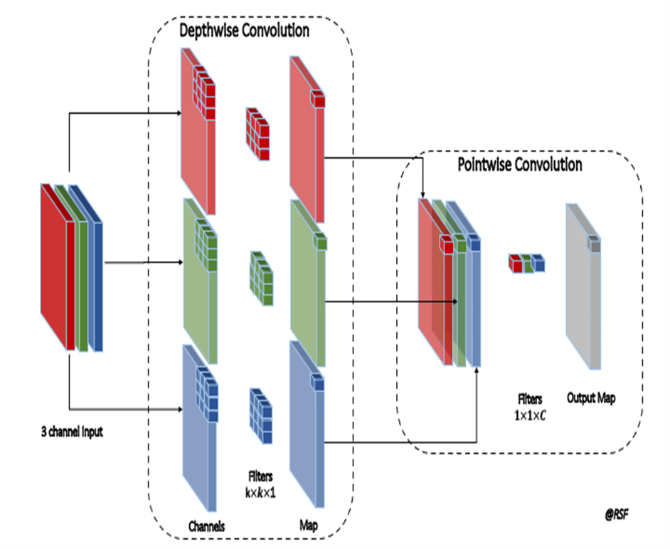
MobileNet
Developed by Google researchers.
Purpose:
Designed for mobile and embedded vision applications.
Focuses on efficient, lightweight models suitable for devices with limited computational resources.
Key Features:
Reduces computational cost and model size.
Fewer parameters compared to traditional convolutional networks.
Maintains competitive accuracy with optimized speed and efficiency.
Applications:
Real-time object detection and image classification on mobile devices.
Deployment in IoT devices and augmented reality applications.
Pre-trained Models:
MobileNetV1, MobileNetV2, MobileNetV3.
Pre-trained on ImageNet, available for transfer learning.
Notes:
Depth wise separable convolution
Parameter Efficiency
Performace

Slide 34
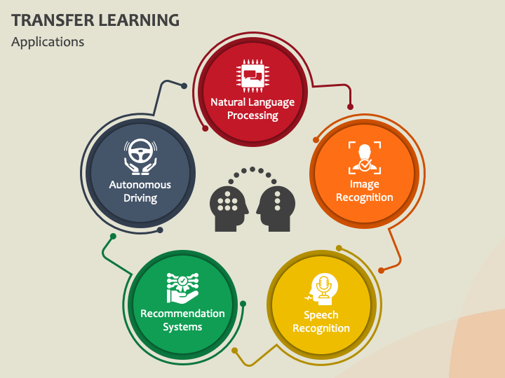
Applications of transfer Learning

Slide 35

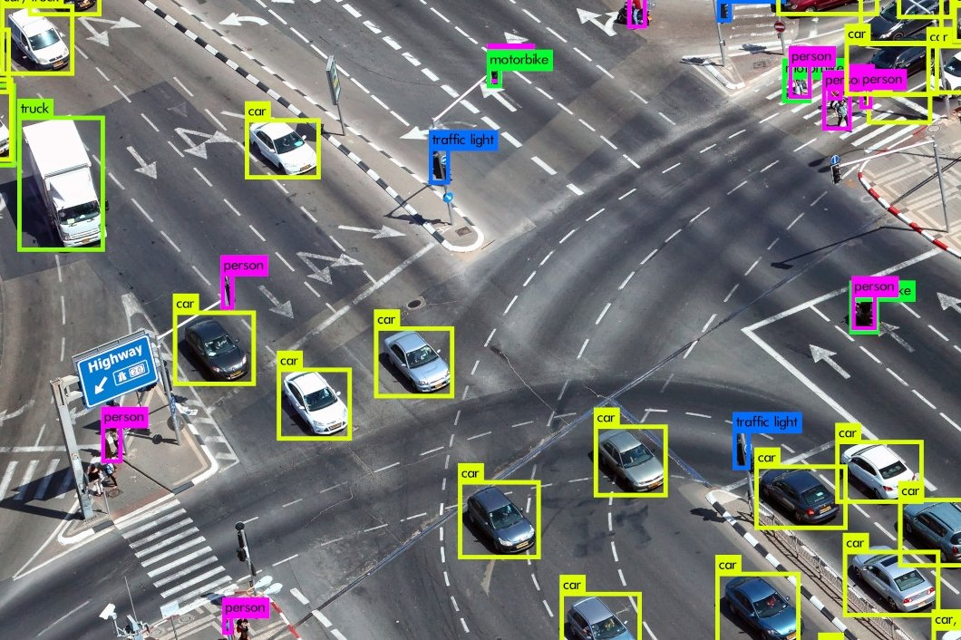
Applications of transfer Learning
Image Classification
A core application of transfer learning in computer vision.
Pre-trained Models
Leverage powerful models like ResNet, VGG, and Inception.
Trained on massive datasets like ImageNet.
Fine-tune models for specific domains.
Applications:
For examples, Identifying species in wildlife photography or diagnosing medical conditions from imaging data.
Object Detection:
Detect and localize objects in images or videos.
Pre-trained Models:
Utilize pre-trained models like YOLO, Faster R-CNN, SSD for feature extraction.
Add layers for bounding box prediction and class identification.
Applications:
Pedestrian detection for self-driving cars.

Slide 36
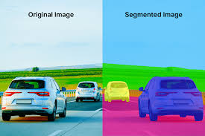
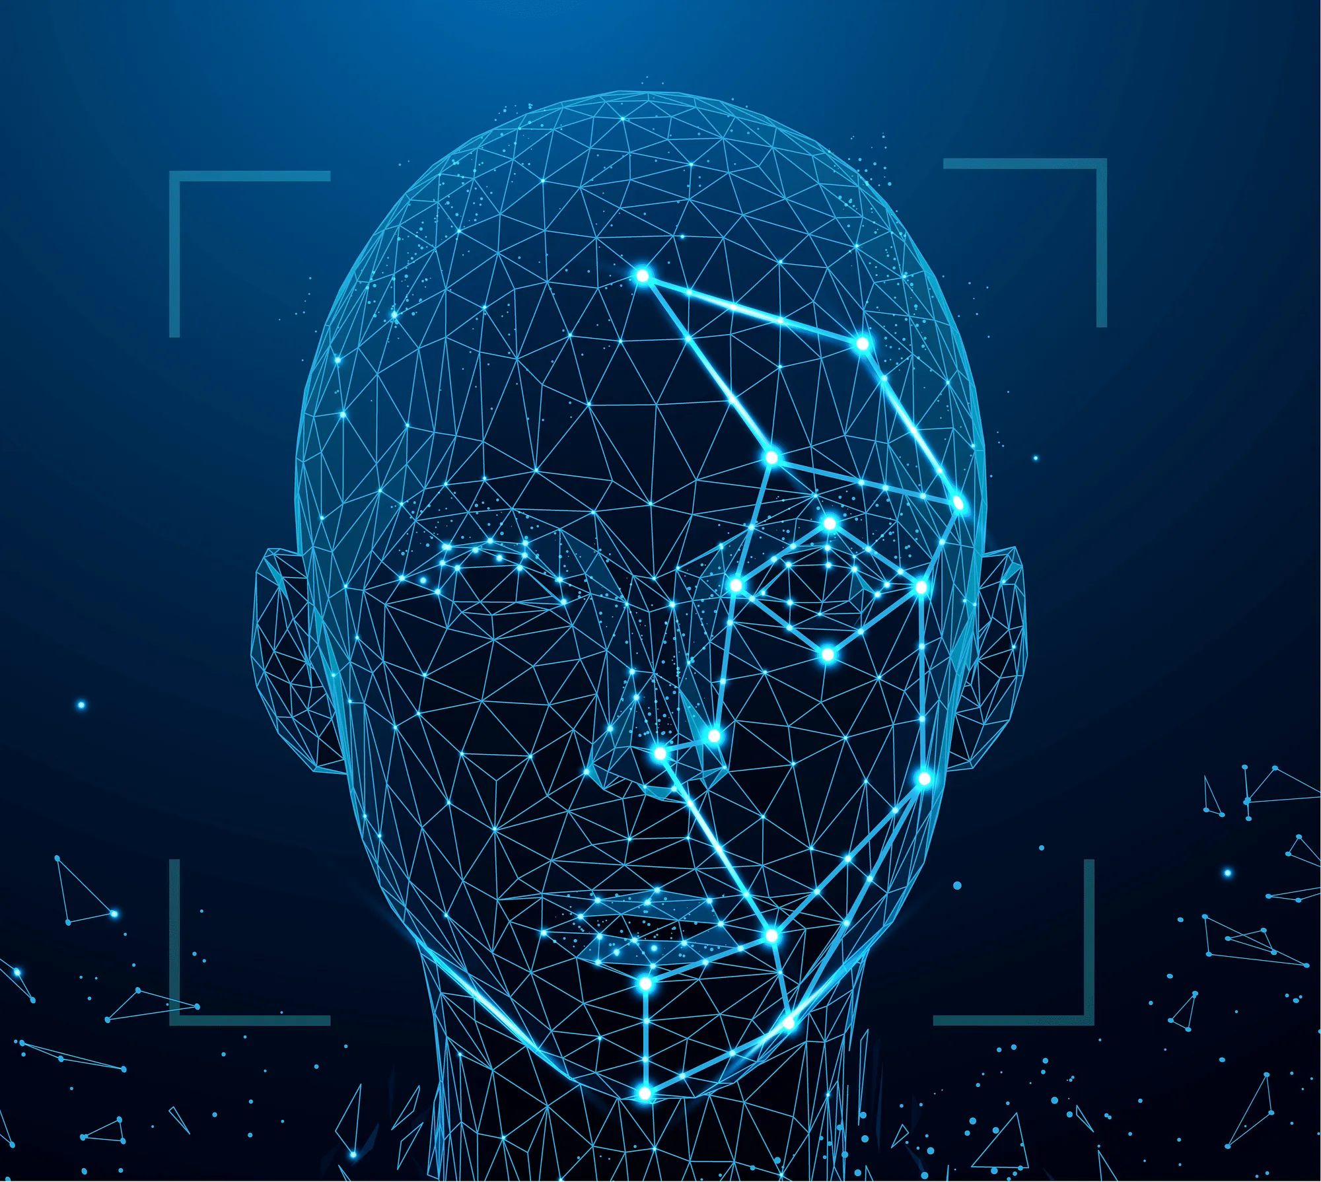
Applications of transfer Learning
Image Segmentation
Segmenting images into distinct regions corresponding to objects or parts of objects.
Pre-trained Models:
U-Net, DeepLab, FCN.
Applications with Transfer Learning
Medical Imaging: Identify tumors or other abnormalities.
Autonomous Vehicles: Differentiate between roads, sidewalks, and vehicles.
Face Recognition:
Identify and verify faces in images or videos.
Pre-trained Models:
Utilize pre-trained models like FaceNet, VGGFace for feature extraction.
Add layers for face identification and verification.
Applications:
Security systems for access control.
Social media tagging.
User authentication for devices and apps.
Notes:
https://deeplobe.ai/image-segmentation-the-most-interesting-applications/
https://medium.com/analytics-vidhya/how-facial-recognition-systems-work-edcbb227e614

Slide 37
References:
https://www.researchgate.net/figure/Change-in-the-number-of-model-parameters-and-training-time-with-increased-number-of_fig3_335865710
https://blog.devgenius.io/all-you-need-to-know-about-transfer-learning-4a7e3cbaf1dd
https://medium.com/@nutanbhogendrasharma/transfer-learning-using-feature-extraction-in-deep-learning-afd97380c96c
https://dev.mrdbourke.com/tensorflow-deep-learning/04_transfer_learning_in_tensorflow_part_1_feature_extraction/
https://encord.com/glossary/pre-trained-model-definition/
https://en.wikipedia.org/wiki/ImageNet
https://blog.mturk.com/tutorial-how-to-label-thousands-of-images-using-the-crowd-bea164ccbefc
https://medium.com/@siddheshb008/alexnet-architecture-explained-b6240c528bd5
62.3 million learnable parameters.
https://www.philschmid.de/getting-started-with-cnn-by-calculating-lenet-layer-manually
https://medium.com/@mygreatlearning/everything-you-need-to-know-about-vgg16-7315defb5918
https://www.geeksforgeeks.org/residual-networks-resnet-deep-learning/
https://viso.ai/deep-learning/resnet-residual-neural-network/
https://www.researchgate.net/figure/A-schematic-view-of-ResNet-architecture-15-decomposed-into-three-blocks-embedding_fig1_333475917

Slide 38
References:
https://medium.com/@siddheshb008/resnet-architecture-explained-47309ea9283d
https://velog.io/@snoop2head/Going-Deeper-with-Convolutions-GoogleNet-Inception
https://towardsdatascience.com/an-intuitive-guide-to-deep-network-architectures-65fdc477db41
https://www.youtube.com/watch?app=desktop&v=pf-HUcqdCr4
https://www.baeldung.com/wp-content/uploads/sites/4/2020/06/3D_1D_cropped.gif
https://arxiv.org/abs/1905.11946
https://deeplobe.ai/image-segmentation-the-most-interesting-applications/
https://medium.com/analytics-vidhya/how-facial-recognition-systems-work-edcbb227e614

Slide 39
Thank You

